Slide 1
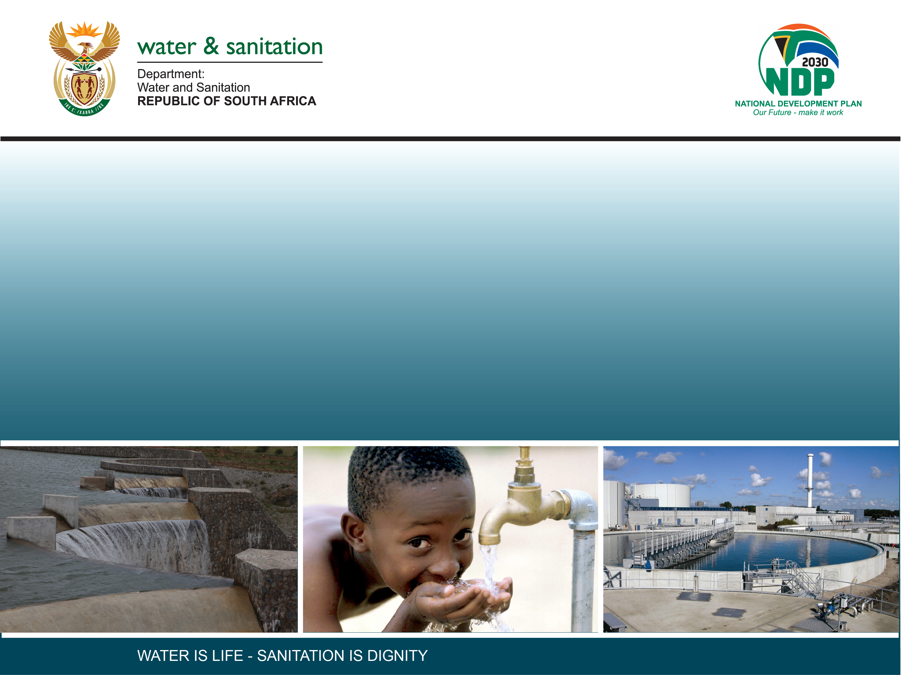
CLASSIFICATION OF SIGNIFICANT WATER RESOURCES AND DETERMINATION OF RESOURCE QUALITY OBJECTIVES FOR WATER RESOURCES IN THE USUTU TO MHLATHUZE CATCHMENTS (WP11387)
BACKGROUND
Presentation by:
Mkhevu Mnisi
Date: 04 May 2022
PUBLIC MEETING, RICHARDS BAY: 4 MAY 2022

Slide 2
PRESENTATION CONTENT
Legal mandate
Definition of Resource Directed Measures (RDM)
Study processes/steps
Study area
Stakeholder Engagement Plan
Communication method
Contact details

Slide 3
Determination of CLASSES AND RQOs IN THE USUTU TO MHLATHUZE CATCHMENTS
The study was initiated in December 2021
Timeframe: 30 months
WRP Consulting Engineers (Pty) Ltd was appointed to assist DWS
The objective of the study is to determine classes and RQOs in the Usutu to Mhlathuze Catchment

Slide 4
Legal Mandate
Chapter 3 of the National Water Act (No. 36 of 1998), deals with the protection of water resources
The Resource-Directed Measures for protection of water resources are:
  Classification (S13)
  Reserve (S16)
  Resource Quality Objectives (S13)
S12 requires the Minister to establish the Water Resource Classification System, (WRCS)
WRCS was published as Regulation 810 in Government Gazette No. 33541 dated 17 September 2010
The WRCS defines:
  water resource classes and
  the procedure to determine Class, RQOs and Reserve
According to the NWA, once the WRCS has been gazetted all significant water resources must be classified and the Resource Quality objectives determined

Slide 5
Definition of Resource Direct Measure (RDM)
Classification: defines the desired state of the water resources by setting Water Resource Classes (l, II, III). Each class represents a different level of protection that is required for the water resource, and the extent to which the water resource can be used.
Reserve: means the quantity and quality of water required for (a) to satisfy basic human needs by securing water supply for people (b) to protect aquatic ecosystems in order to secure ecologically sustainable development and use of relevant water resource.
RQOs: are numeric or descriptive statements of conditions which should be met in the receiving water resource. The objectives are determined for: quantity, quality, habitat & biota.

Slide 6
Study Area
The study area is the Usutu - Mhlatuze Catchments
Divided into 6 drainage areas/secondary catchments:
  Mhlatuze, W1
  Mfolozi, W2
  Mkuze/Hluhluwe, W3
  Pongola, W4
  Usutu, W5
  W7 catchment.

Slide 7
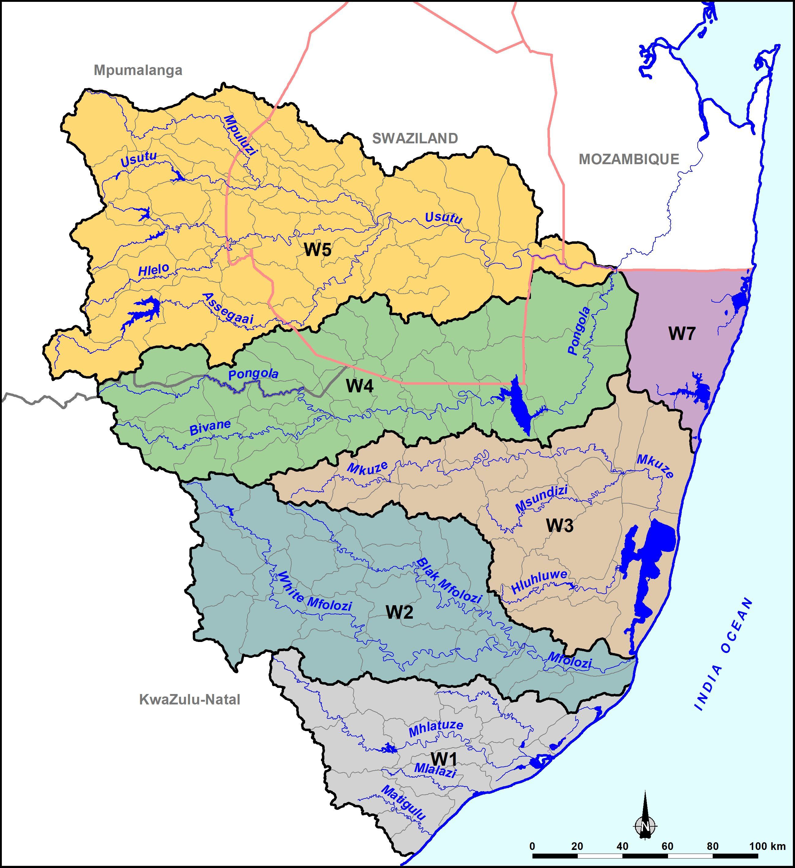
Study Area

Slide 9
Process of Determining Resource Quality Objectives
RQOs 7-Step Procedure
1. Delineate the IUAs and RUs
2. Establish the vision for the catchment
3.
Prioritise & select RUs
4. Prioritise sub-components, select indicators & propose direction of change
5. Develop draft RQOs & numerical limits
6. Agree RUs, RQOs & numerical limits with stakeholders
Monitoring & Compliance
7. Finalise & Gazette

Slide 10
Stakeholder Engagement Plan
Platforms | Stakeholder groups | Purpose
Public Meetings | The broader public | To announce the project & To present the proposed classes & RQOs (04/05/2022)
Project Steering Committee | Representatives from various Sectors | To give strategic inputs to the project (07/06/2022)
Technical Task team Meeting | Representatives from sectors with technical knowledge of study area and water resource management | To source comments and inputs on technical aspects of the project
Forums | Catchment management forums | Share project progress
Sectors | Different sectors e.g. Domestic, Agriculture, mining etc. ( where necessary). | Share project progress

Slide 11
Public meeting/ stakeholders engagement
Objectives:
Ensuring understanding: transparent process of engagement & communication will be undertaken to ensure stakeholders are informed.
Involving stakeholders in the assessment: to improve the management process of this project
Building relationship: to enable the Department and stakeholders to share knowledge and expertise.
Managing expectations: to reduce the potential for future conflict.
Effective communication: for successful project outcome, simply producing reports is not enough.

Slide 12
Public meeting: Targeted stakeholders
Agriculture
Emerging Farmers
Mining – COM and mining houses
Industries
Local government – local and district municipalities in Catchment
Conservation
NGOs
Regulators
Water Service Authorities/Providers
Information/Academic institutions – libraries, universities
Unions & House of Traditional leaders
Catchment Forums & WUA
Civil society and the environment representatives
Community members (public at large)

Slide 13
Communication method
    Direct communication via meetings
    Identified Platforms: Project Management Committee (PMC), Project Steering Committee (PSC), Technical Task Group (TTG), Existing Forums, Sector, Public Meetings
    Print media
    newspaper adverts
    BIDs, newsletters
    Electronic media
    DWS internet site ( www.dws.gov.za/rdm/WRCS/default.aspx )
    Emails
  NB: Stakeholder database and Issues & Response Register to be updated regularly

Slide 14
Contact details
Mkhevu Mnisi
Tel: 012 336 8956
Email: mnisim2@dws.gov.za
Koleka Makanda
Tel: 012 336 8406
Email: makandac@dws.gov.za
Caryn Seago
012 346 3496
kcaryns@wrp.co.za

Slide 15
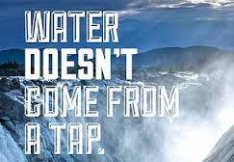

THANK YOU!

